Slide 1
Adopt a School for its Feeding Program at 8 Rural Schools in Kabankalan, Negros Occidental, Philippines A non-profit organization recognized & acknowledged by the Department of Education Kabankalan City Division

Slide 2
Feeding Program is a non-Government project run by civic group that aims best in providing food on the table to the children of poor and landless laborers at the sugar cane fields in rural areas of Kabankalan, Negros Occidental, Philippines.
Feeding Program alleviates hunger and improves nutritional status of students from Grades I to VI and improves students’ school attendance and class performance.
Feeding program provides opportunities to students to stay at school and complete their Elementary Education (completing Grade VI) which is a stepping stone to proceed to high school or obtain vocational training for a livelihood program.
It is envisioned through the Feeding Program that the vicious cycle of poverty and misery is minimized on the students who greatly benefit from this project.

Slide 3
3315 students from Grades 1 to 6 in 8 rural public schools given lunch with an appropriation of P5.00 per student, equivalent to $0.12 cents Australia per day.
School | School Year 2011-12 | School Year 2012-13 | Net Enrolment Increase
Hilamonan Elementary | 447 | 565 | 118
Casipsipan Elementary | 383 | 400 | 17
Orong Elementary | 426 | 520 | 94
DC Gurrucharri Elementary | 553 | 630 | 77
Bino Primary | 176 | 216 | 38
Camugao Elementary | 106 | 126 | 20
Bugtong Primary | 204 | 249 | 45
Tanawan Elementary | 584 | 611 | 27
Total | 2879 | 3315 | Total Net Increase: 15%

Slide 4
Acknowledgement & Recognition by a School Superintendent, Department of Education, Kabankalan City Division, Negros Occidental, Philippines

Slide 5
CERTIFICATE OF ACKNOWLEDGEMENT & RECOGNITION

Slide 6
Images of Children in Feeding Program

Slide 7
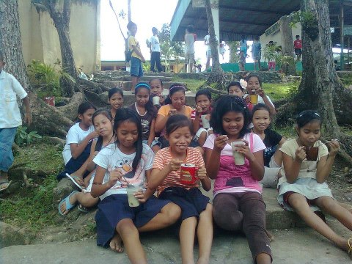
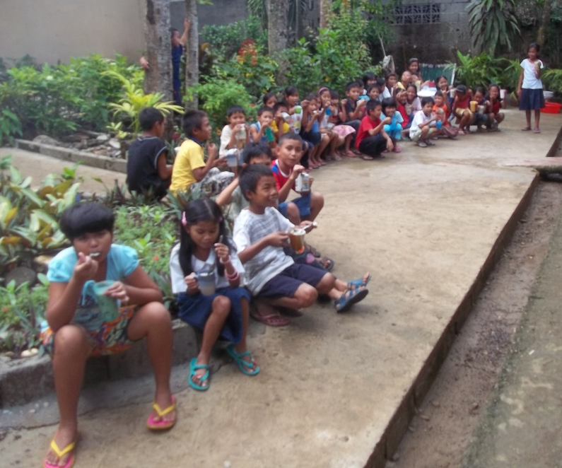

Slide 8
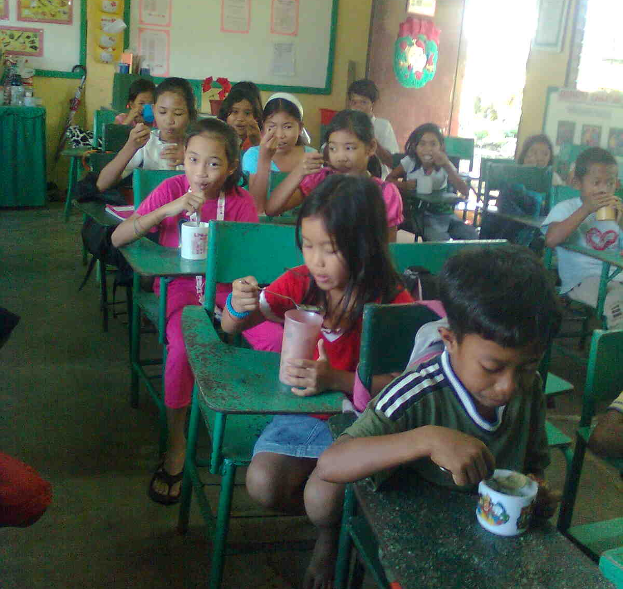

Slide 9
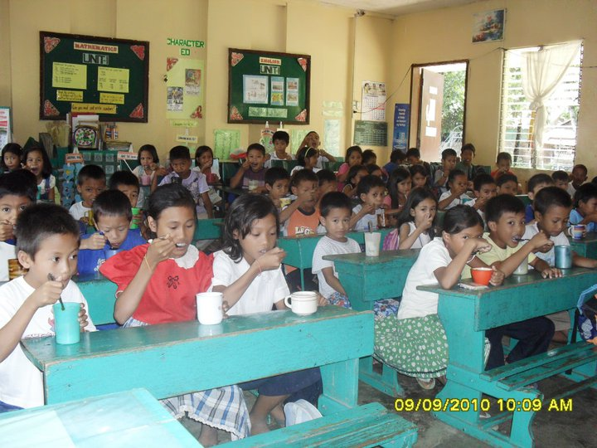

Slide 11
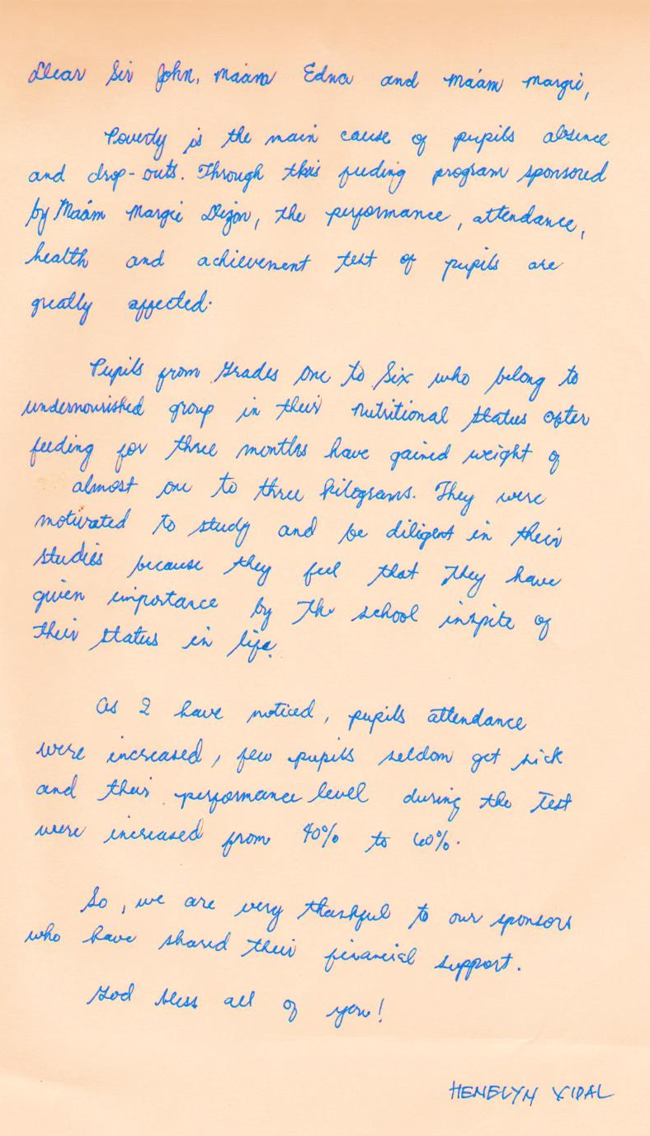
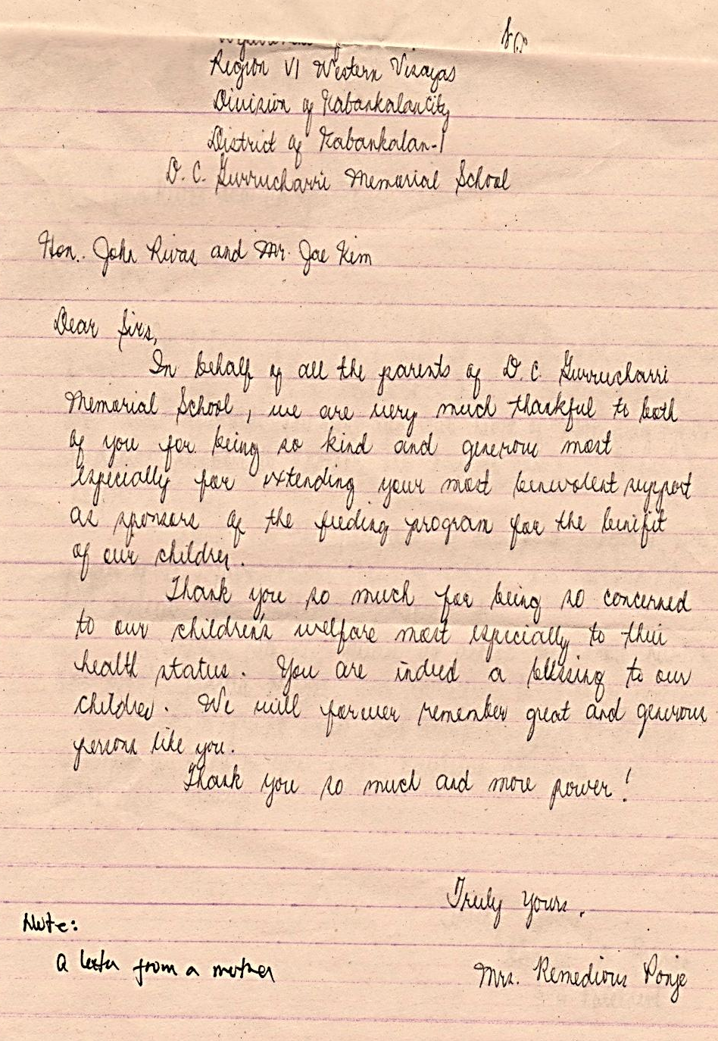

Slide 12
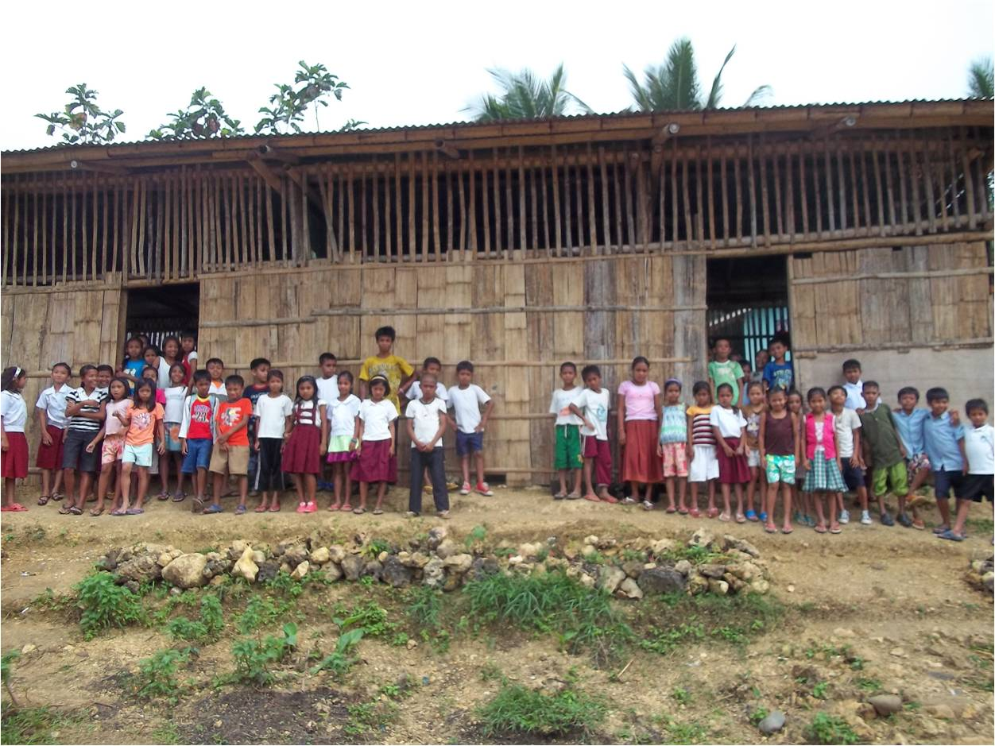
Thank you! Your generosity and benevolence will help us through our Elementary School Education

